Slide 1
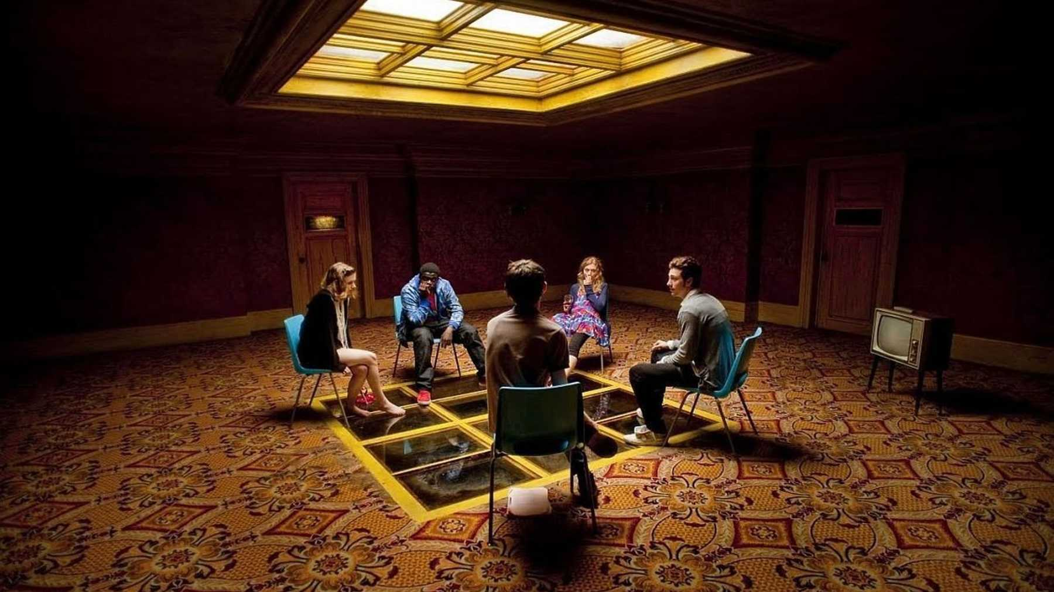
MINOR PROJECT
SNEEK CHATROOMs
This Photo by Unknown Author is licensed under CC BY-NC-ND

Slide 2
PRESENTED BY :
NITIKA RAWAT
(09590202019)
SNEHA CHOUDHARY
(07790202019)
SGTBIMIT
BCA - 5B

Slide 3

TABLE OF CONTENT
Introduction
Diagrams
Working of project
Conclusion & Future Scope

Slide 4


01
INTRODUCTION

Slide 5

Selling your idea
Communication is a mean for people to exchange their thoughts and express themselves in all ways possible, be it gestures, words, dance, music humans can communicate in many ways they just need someone who understands their ways of expressing things. Similarly nowadays many people are adapting to online chatting which is also one out of the many ways of expressing and communicating. With the emergence of computer network and telecommunication technologies bears the same objective that is, to allow people to communicate regardless of how much distance is between them. Therefore, chatting is a method that using technology to bring people and ideas together despite of geographical barriers. Our project CHAT APPLICATOIN is an example of a chatting platform. It is a single page web application made by using JavaScript framework React JS and firebase services that allows its users to easily communicate with their friends and family by allowing user to create chat rooms, and also it gives user the opportunity to make new friends. This application can run on laptop as well as on mobile screen. To start chatting our client should sign-in using Google authentication and get connected to server where they can do group and private chatting by creating chat rooms.
INTRODUCTION

Slide 6

Proposed System: The proposed system is a global chat-room platform allows its user to create chat room and start communicating to people. It allows its users to create their global presence by maintaining their profile details. Key Features of Proposed System: Easy user log-in/sign-in. Chat rooms for chatting. Chatting with their friends and family. Sharing files, pictures, audio and documents easily. Make new friends. User friendly application. Maintains one’s privacy Easy navigation through web application. Easy user data maintenance. Advantages for Users: User can create chat rooms User can chat with their friends and family. Also can make new friends. User can manage its profile: username and profile photo update option. User can view other member’s profile. Easy navigation. Easy sharing and download of files: images or other document files. User friendly.

Slide 7
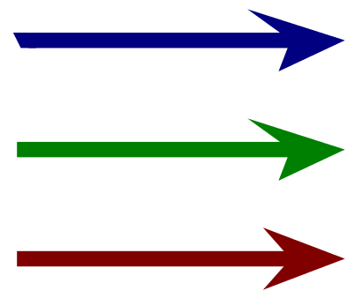
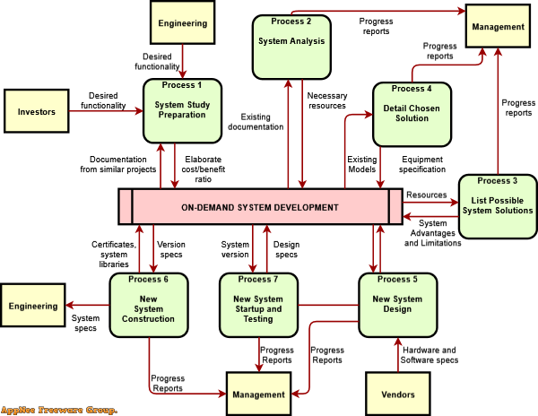
02
DIAGRAMS

Slide 8
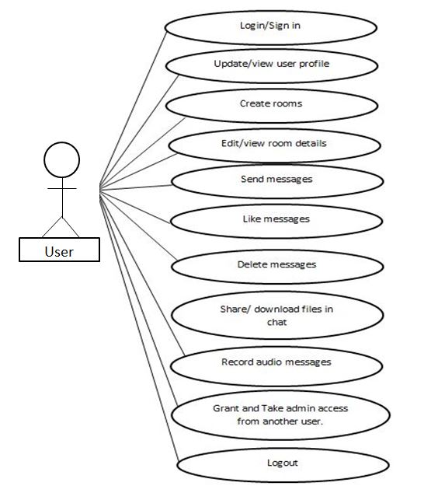
1. USE CASE

Slide 9
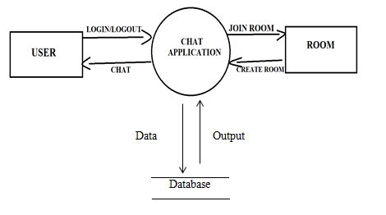
2. DATA FLOW DIAGRAM(LEVEL 0)

Slide 10
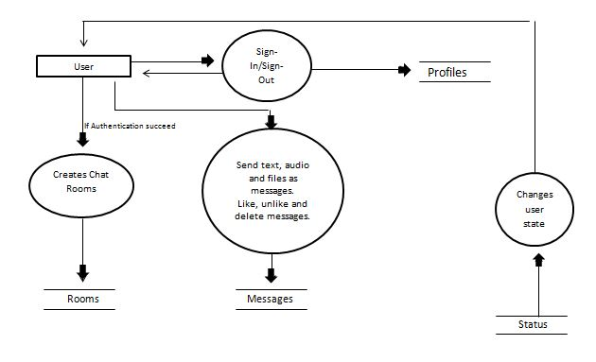
3. DATA FLOW DIAGRAM(LEVEL 1)

Slide 11
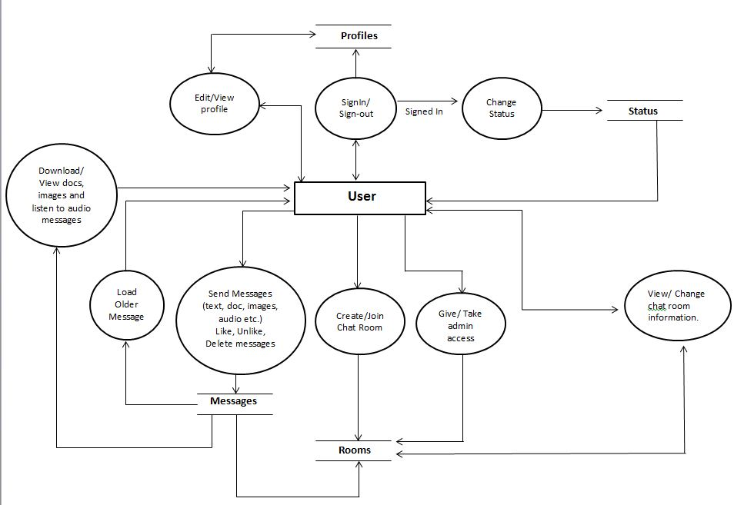
4. DATA FLOW DIAGRAM(LEVEL 2)

Slide 12
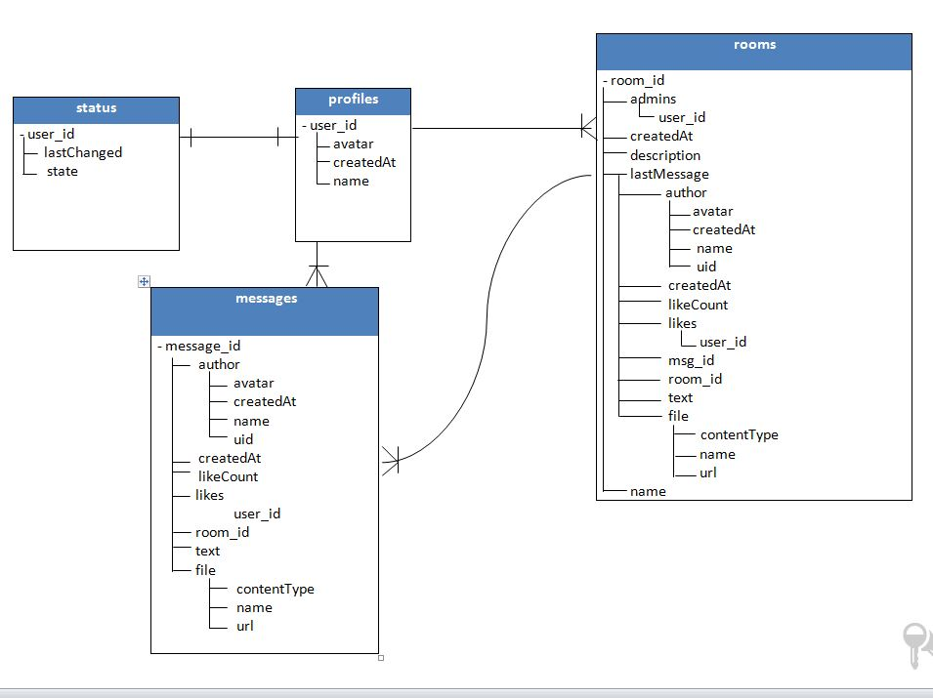
5. DATA MODEL DIAGRAM

Slide 13


03
WORKING OF PROJECT

Slide 14
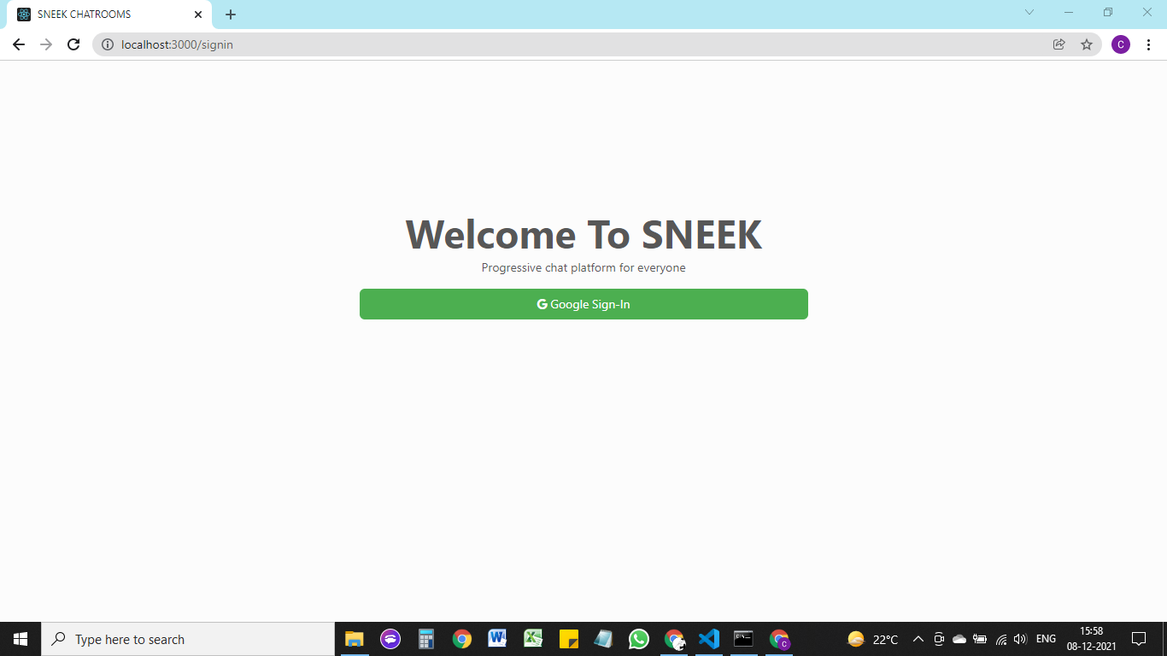
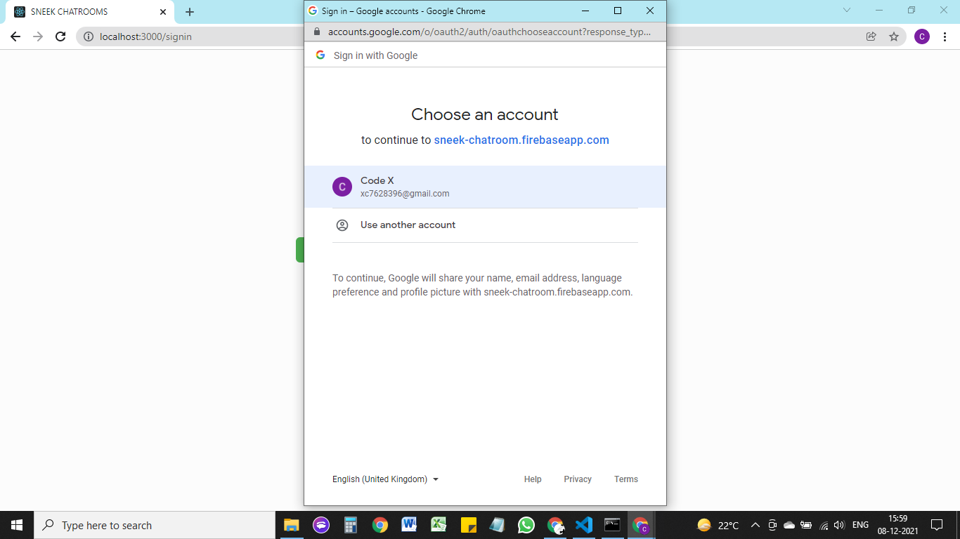
*1. SIGN IN WITH GOOGLE
Click on button to open Google authentication window for signing-in

Slide 15
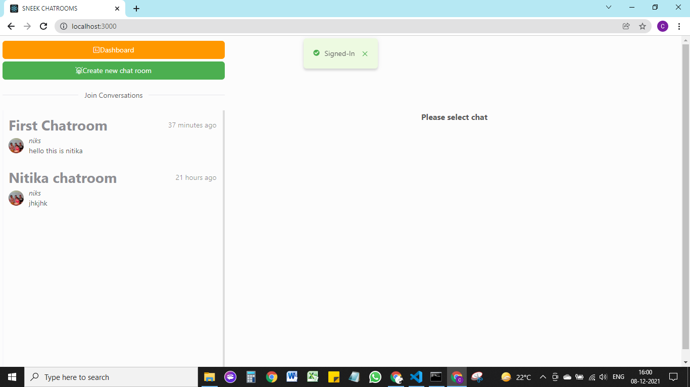
Signed – In as new User

Slide 16
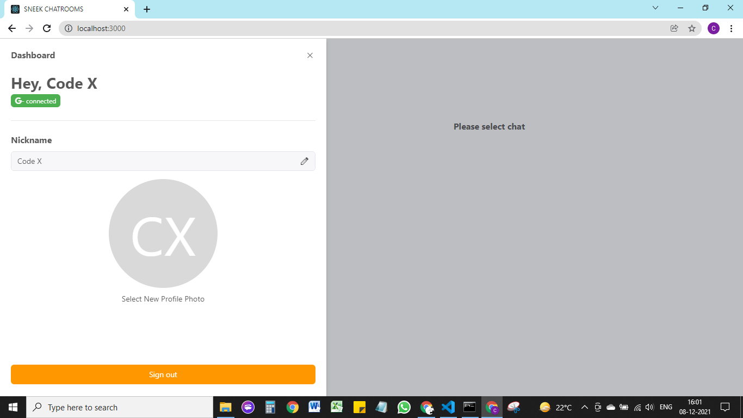
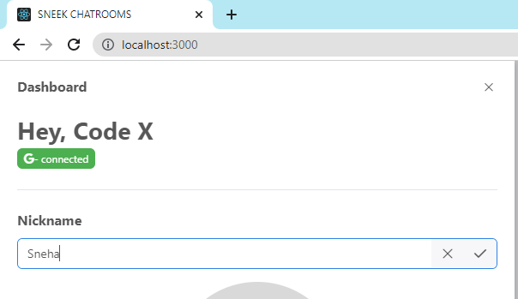
*2. DASHBOARD (EDIT YOUR PROFILE)
Click on pencil icon to change your nickname/username
Write new name

Slide 17
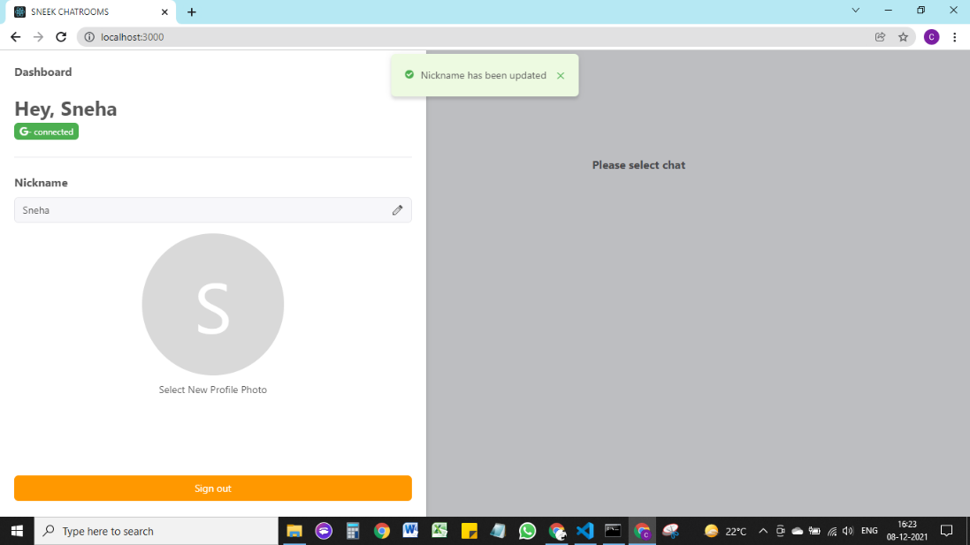
Name Updated
Clcik on text to update or add new Profile picture/Avatar

Slide 18
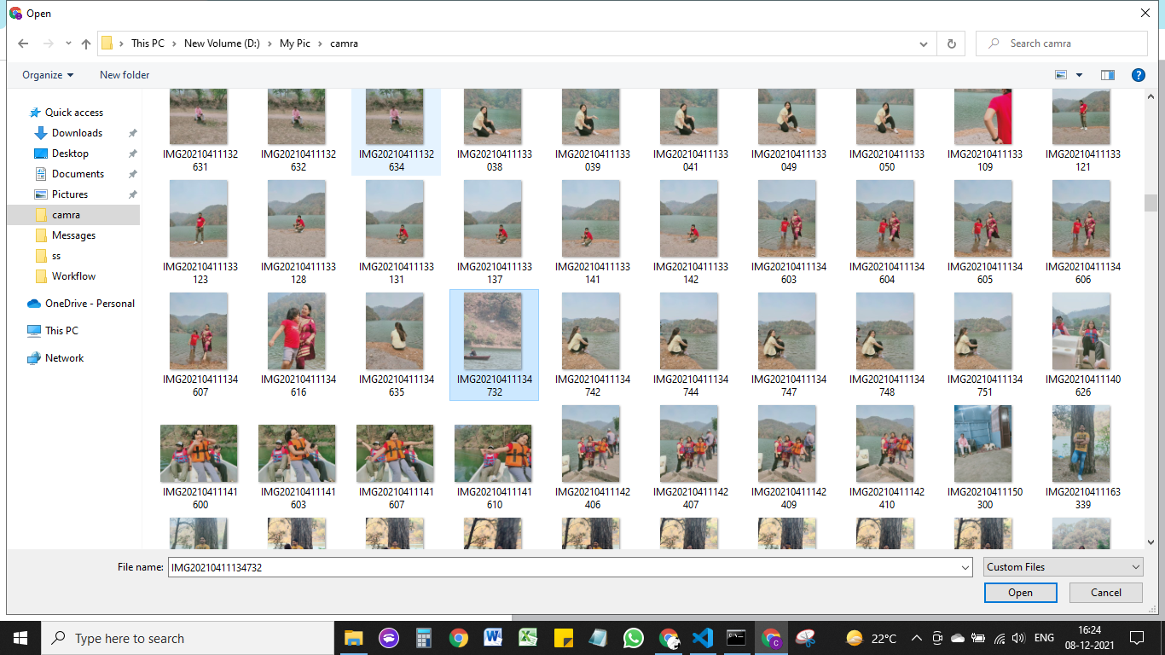
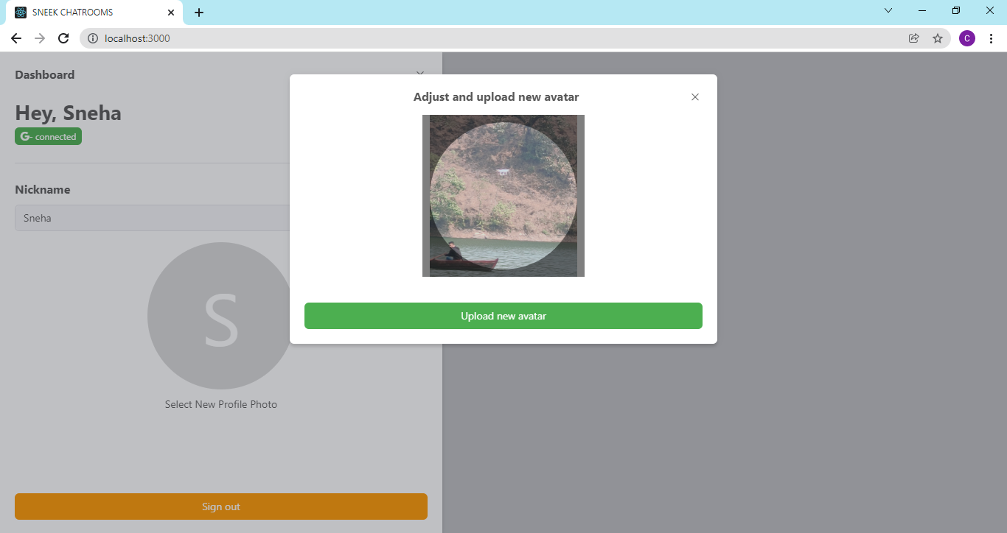
Select image from your pc
Adjust image/avatar
Click on upload avatar button to uplaod image.

Slide 19
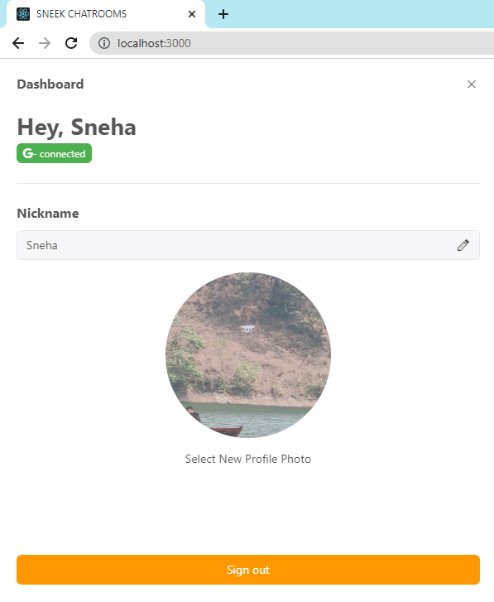
*****Profile Updated
Avatar uploaded

Slide 20
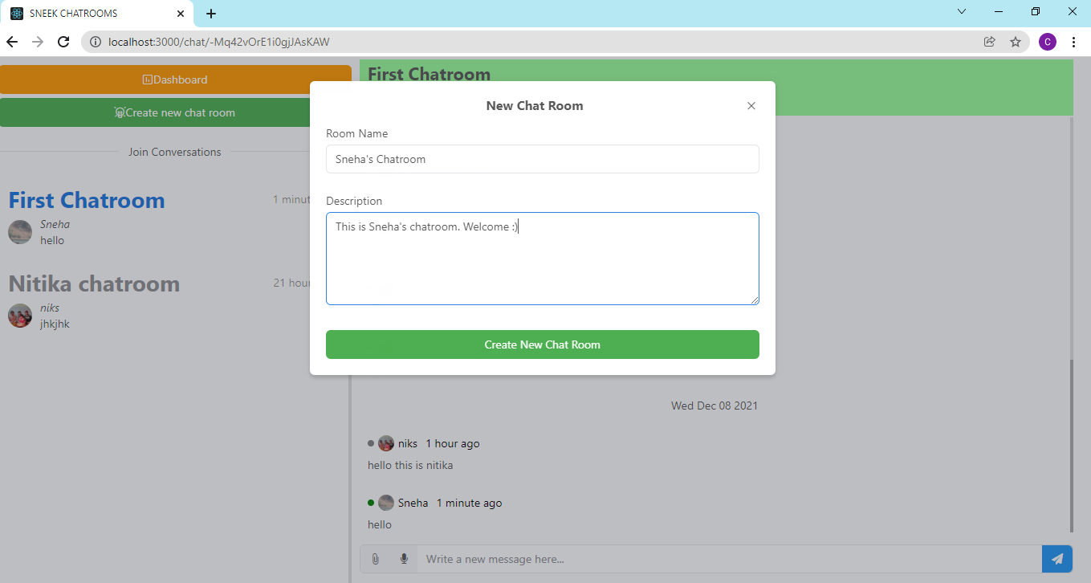
*3. Create Chat Room
Enter chat room name
Enter chatr room description (Both are required field).
Click on create new chat room button to create new chatroom
Click on button after filling details to create room.
**Or you can just join any chat room in application by clicking on chat room name on left (list of room in application) and start texting.

Slide 21
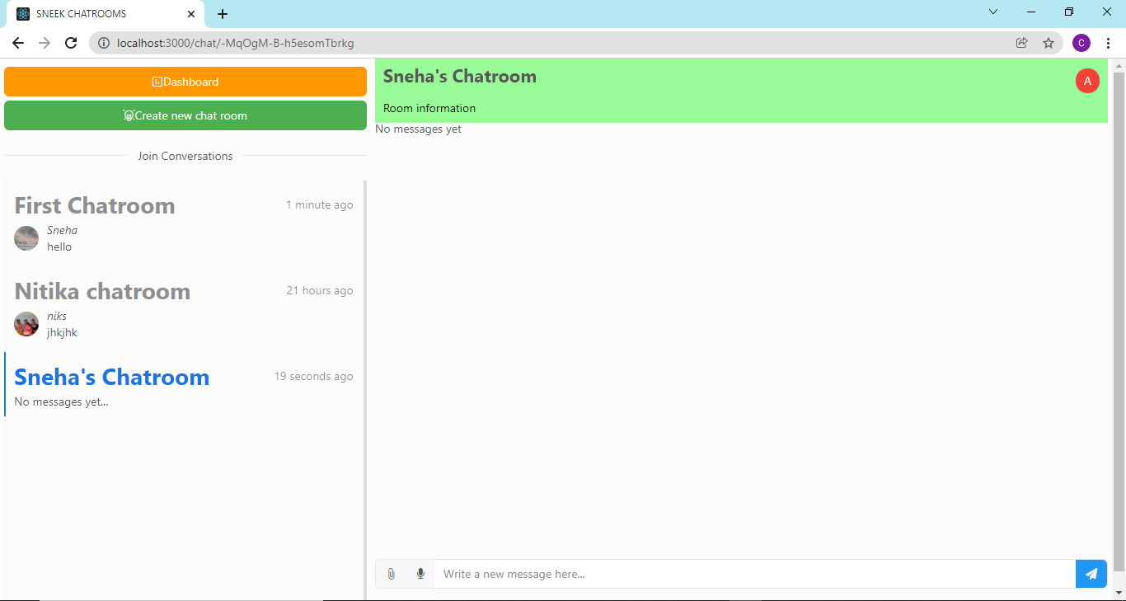
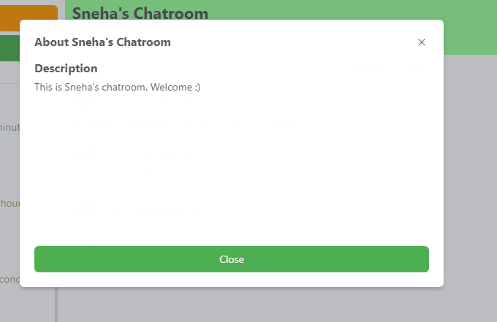
Chat room name and last message and user who sent is shown here.
Chat room name that you’ll write
Button visible only to admin of chat room
Click to view room information (name and description)

Slide 22
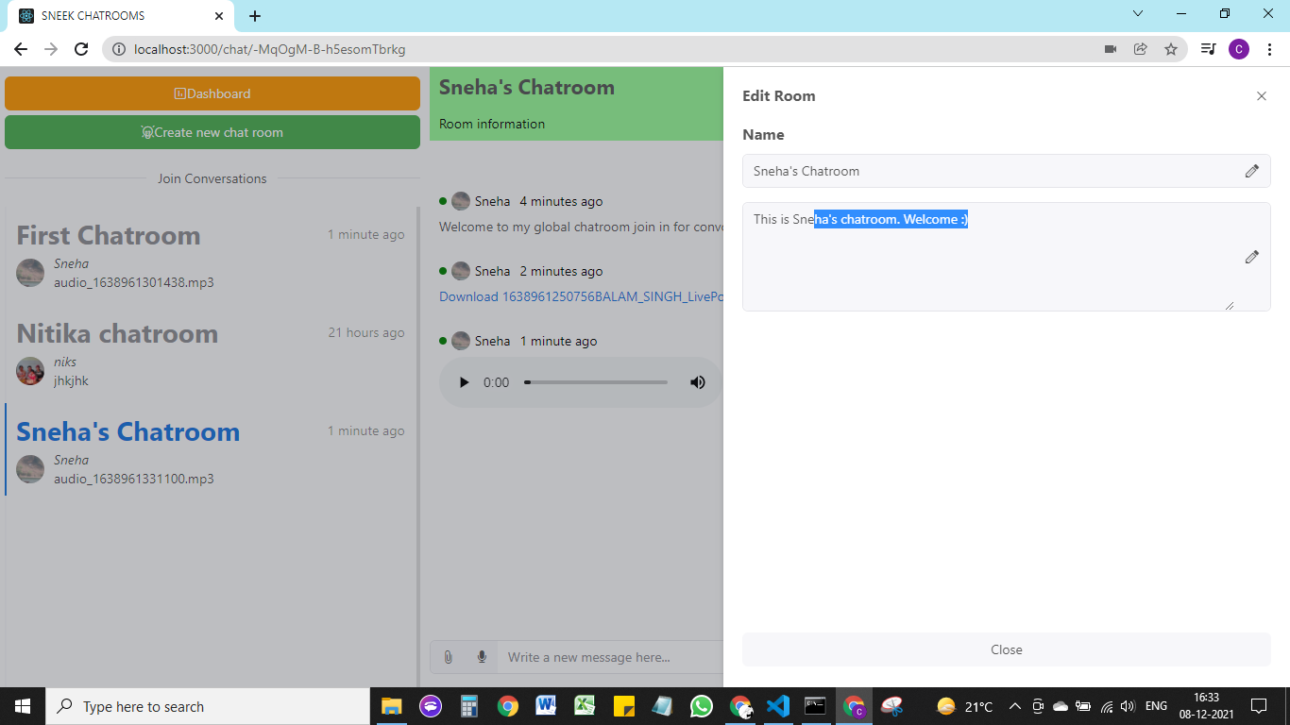
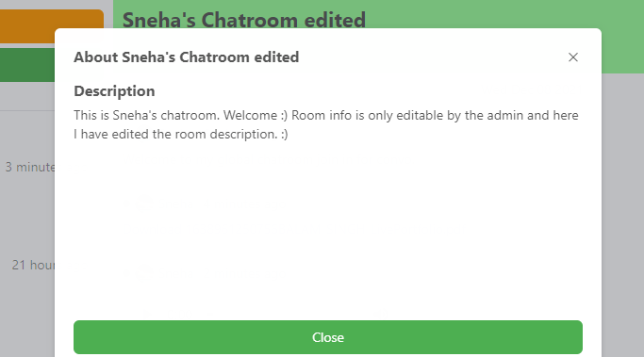
When clicked on right corner button that is only visible to admins Edit Room slidebar is opened
*4. ADMIN ACCESS
Edit chat room name/ new room name.
Enter new room description.
click on room information after editing room information to view new information

Slide 23
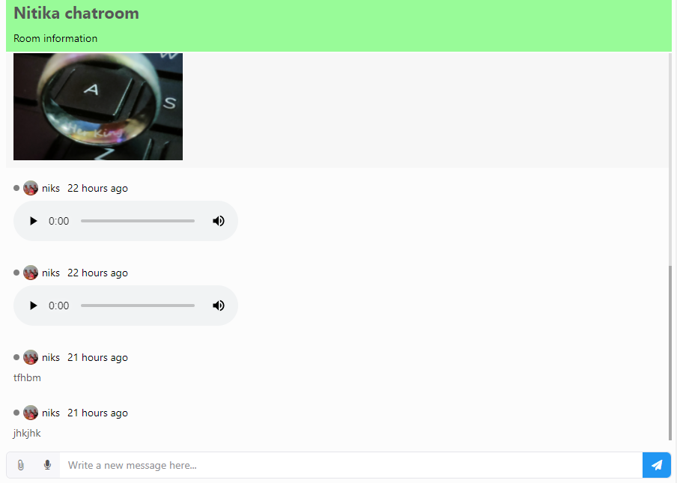
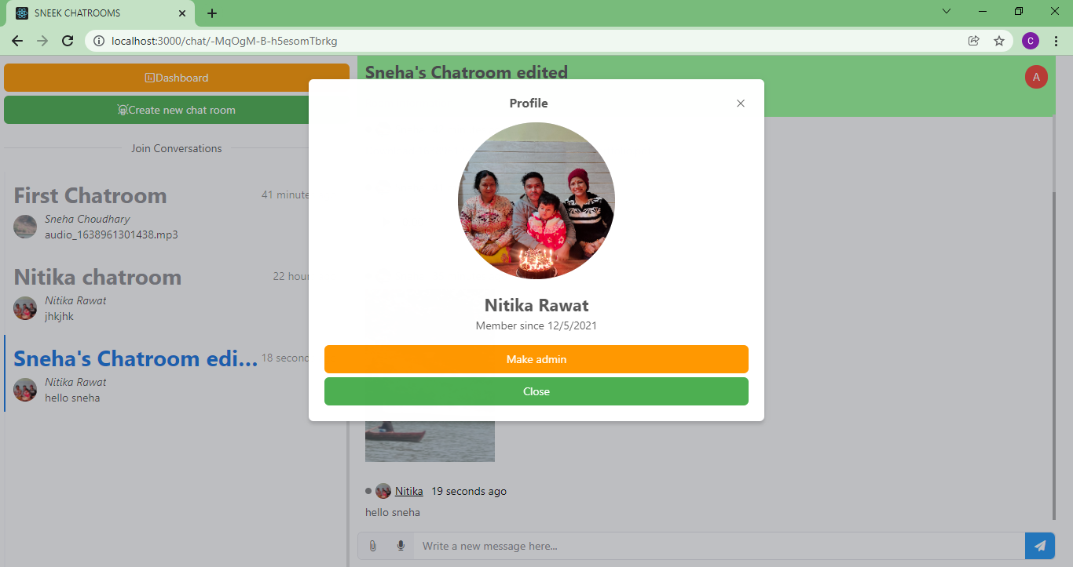
No Admin button for non admin members.
Click to give admin access
Click on non admin members name to view their profile and give admin access.

Slide 24
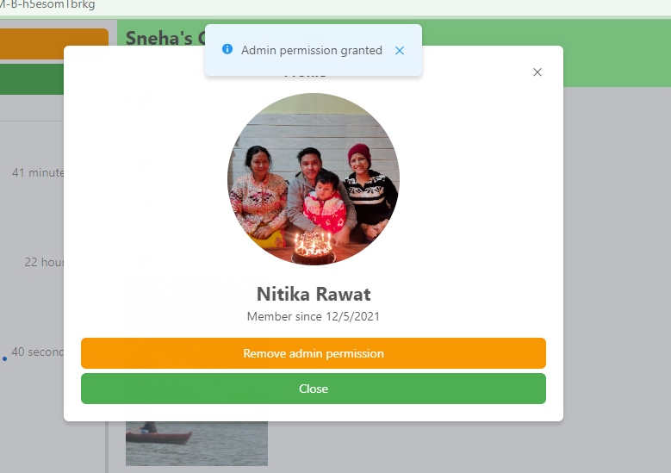
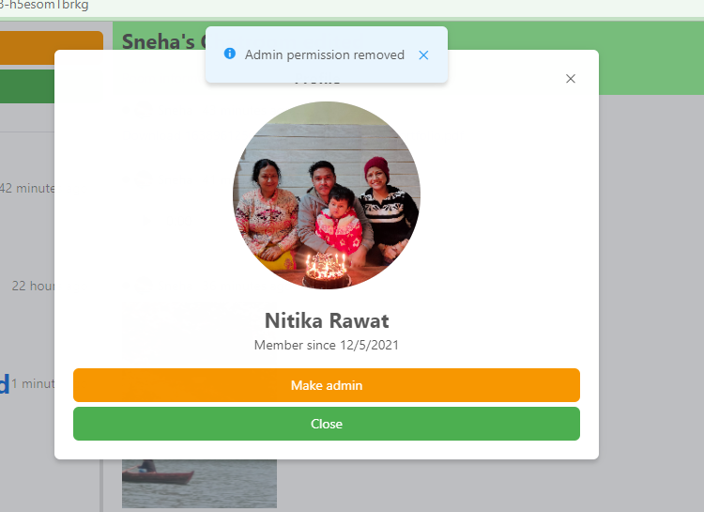
Admin access granted to room member
Admin access removed
Click on button to retake admin access.

Slide 25
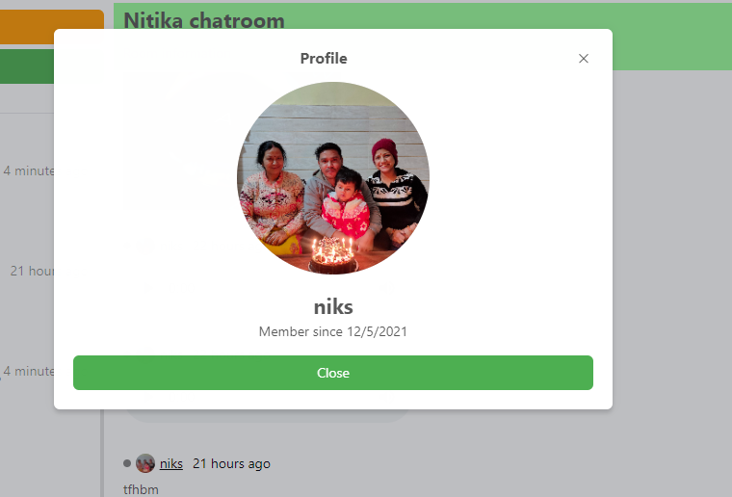
*5. VIEW OTHERS PROFILE

Slide 26
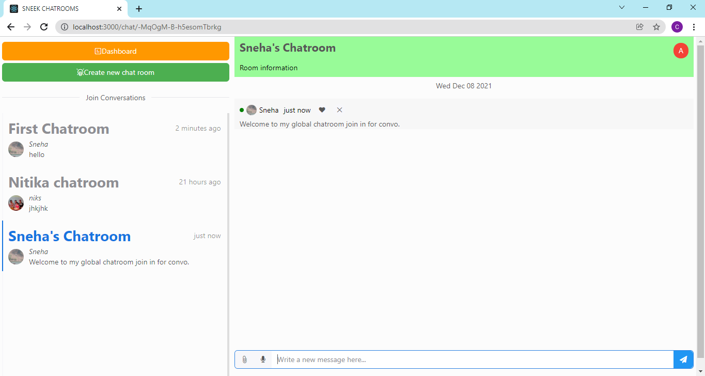
*6. CHAT FEATURES
Message sent to chat
Date when chat was initiated.
Click to send message to chat
Write text messages here

Slide 27
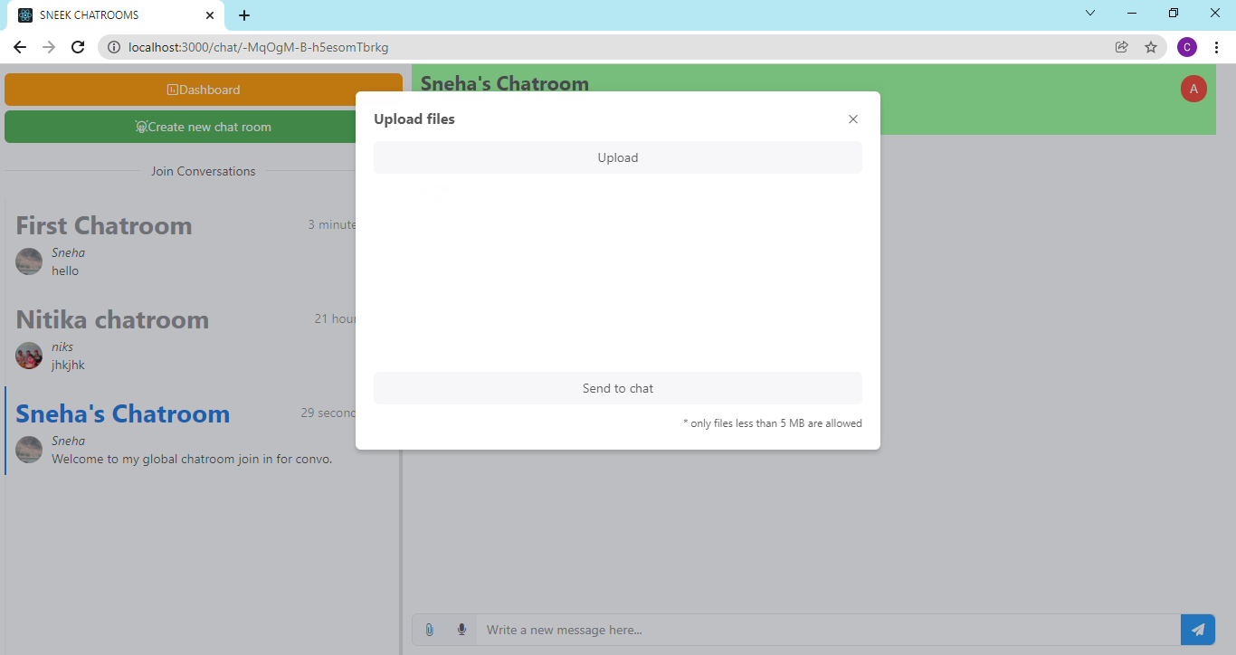
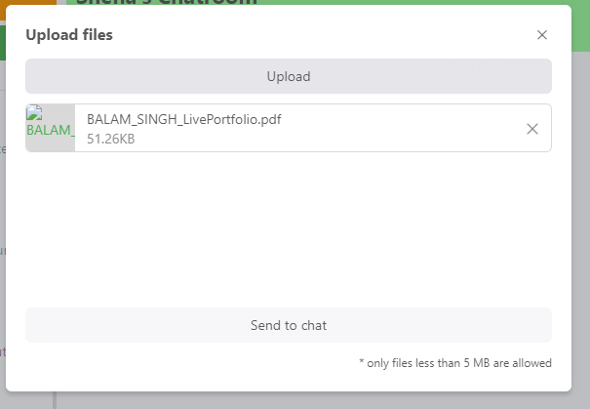
Upload files window opens when clicked on attachment icon
Click on upload to open folder on your pc to select files (5 at a time and only files less than 5 MB are allowed).
Click on icon to send files in chat (documents type, images etc.).
Click to send selected files to chat

Slide 28
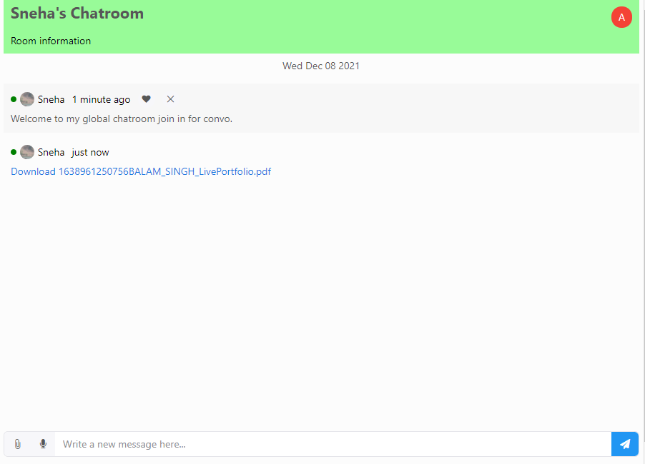
File sent to chat as a link with file name.

Slide 29
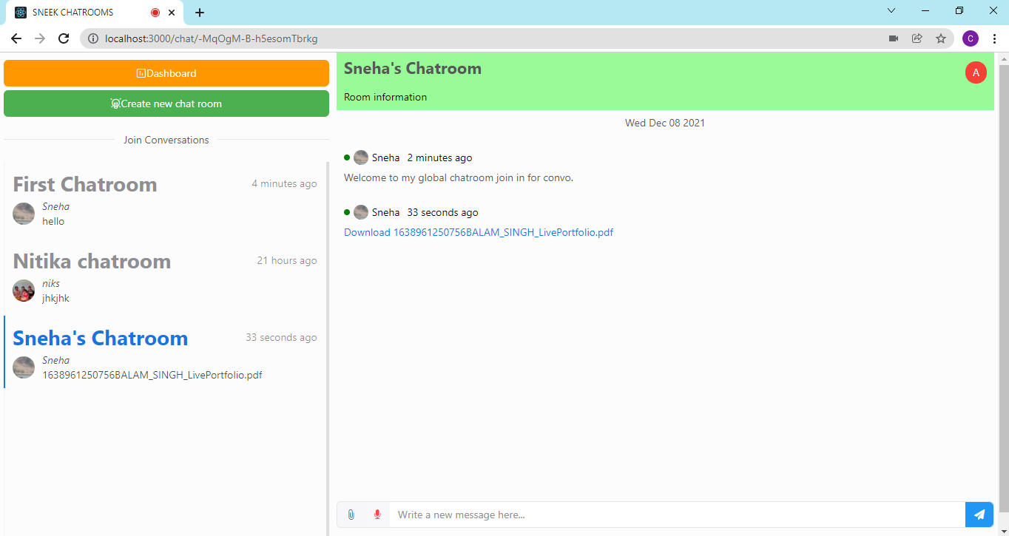
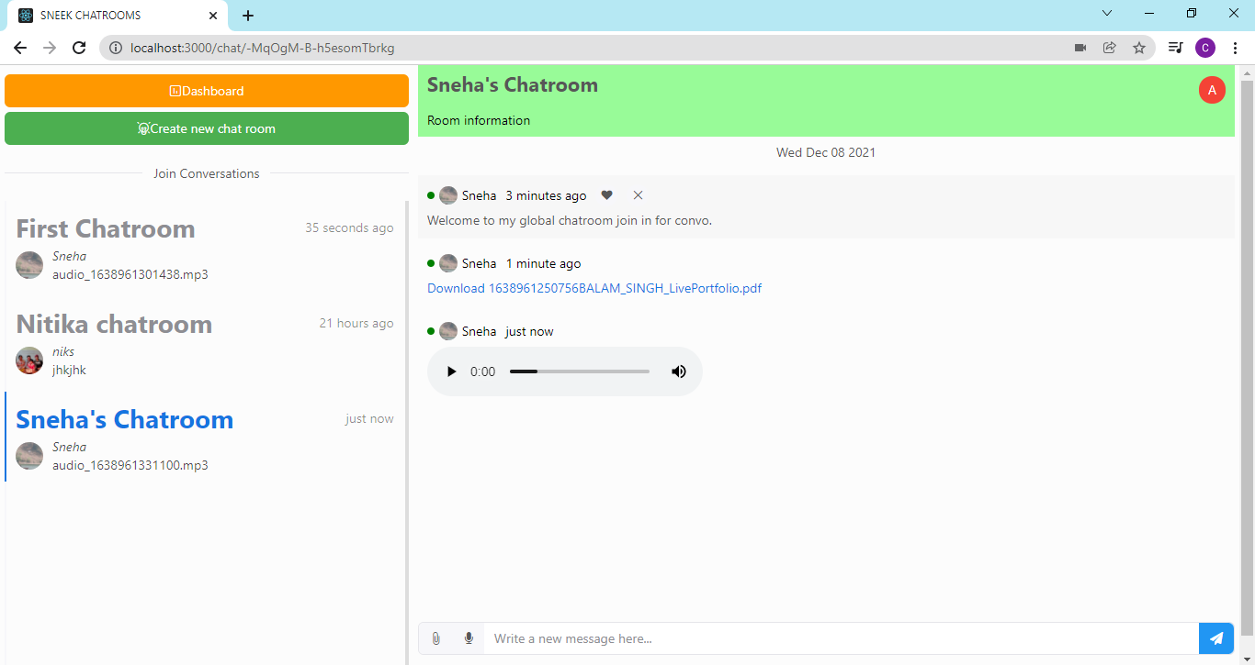
Red dot indicating recording in process
Voice message sent when click on microphone icon again to stop recording
Click on microphone icon to start recording.

Slide 30
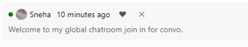
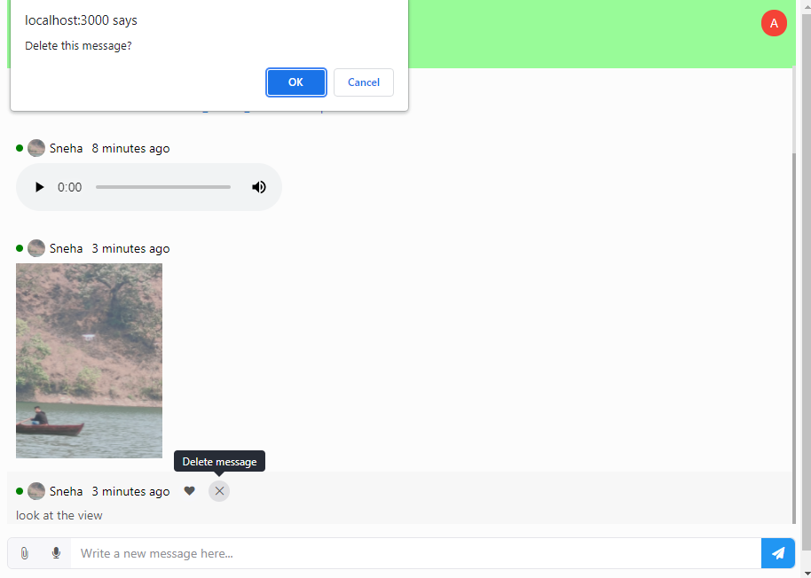
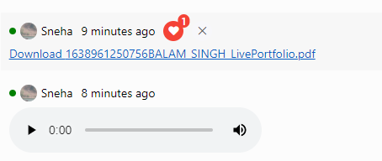
******Message
User who sent message.
Like message button.
Delete message button.
Confirm you want to delete message.
How many time ago message was sent.
Click on files messages to view and download them.
Click to like message. Number on heart indicate how many people liked the message
Click on images to view them
Click to delete message.

Slide 31
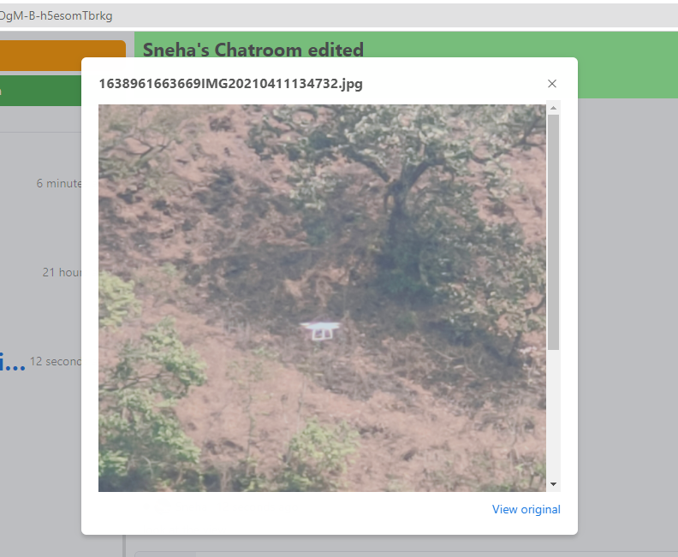
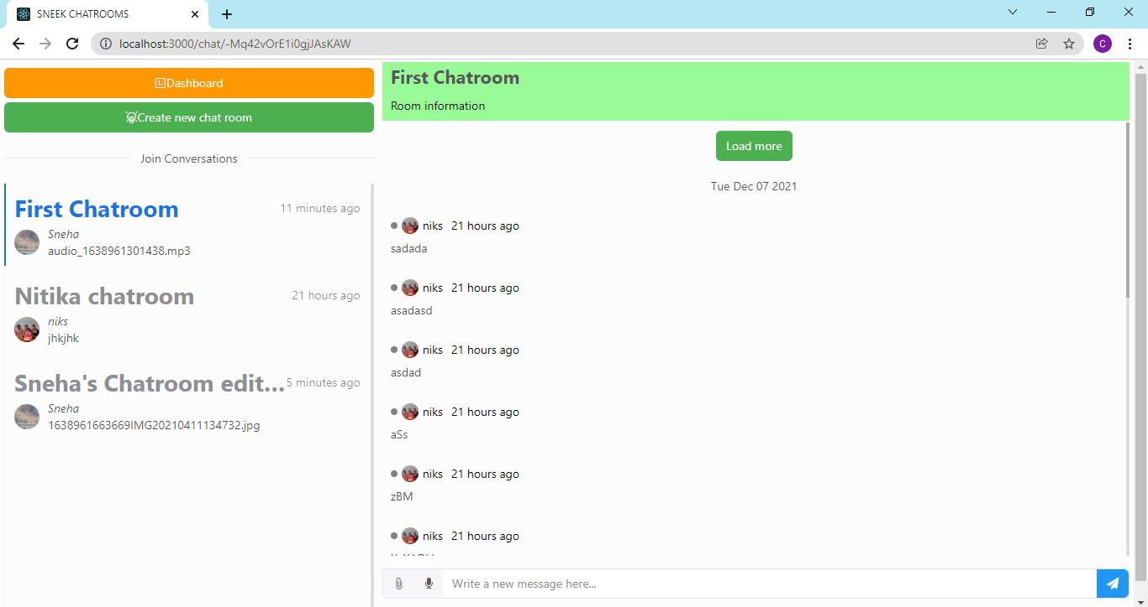
When clicked on any image type document. Image viewing window opened.
Click on load more button to load older messages
Go to view original to view image and download it.

Slide 32
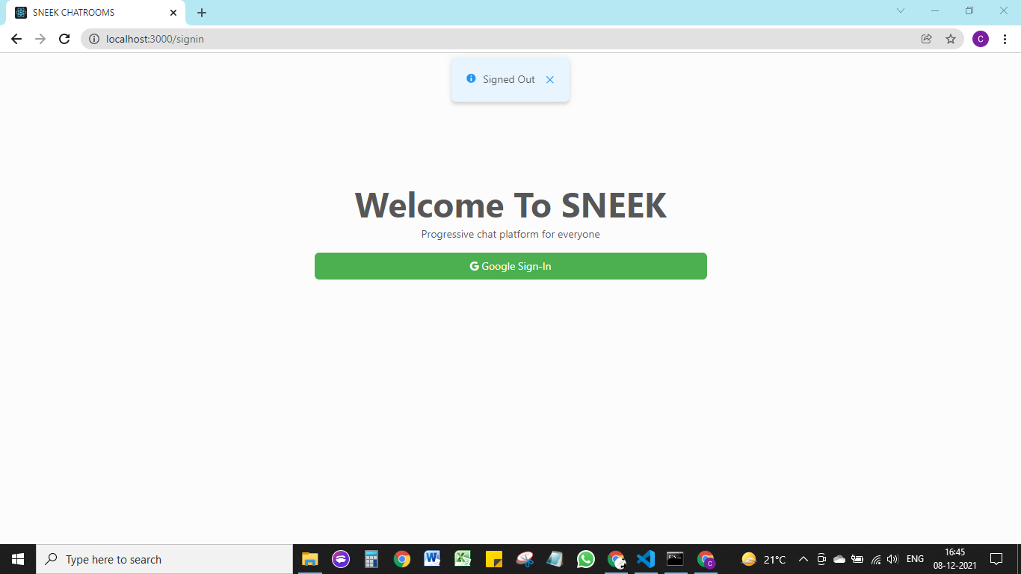
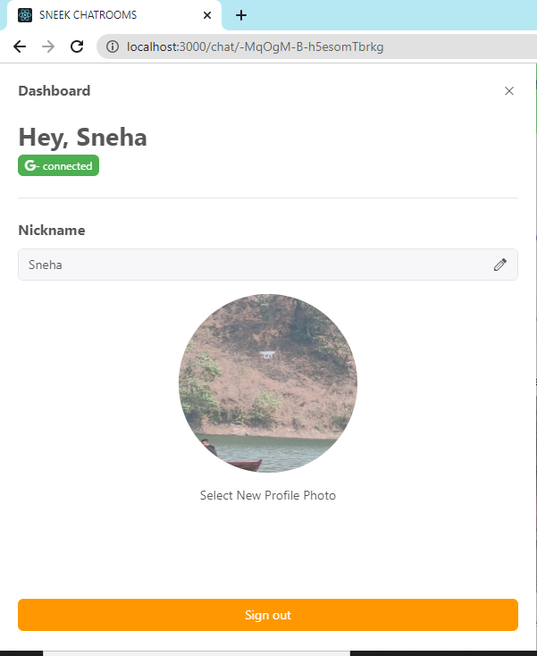
*7. SIGN OUT
Go to dashboard for sign out option.
Signed Out.
Click on button to sign out.

Slide 33


04
CONCLUSION & FUTURE SCOPE

Slide 34
CONCLUSION
In a nutshell our project SNEEK CHATROOMs chat application is a single page web base application developed in order to chat among friends, colleagues, family members. We have made this chat application with JavaScript framework React JS and firebase for hosting and maintaining firebase real time database and other services like storage. React is one of the most popular and powerful front-end technology tools around the world used by well recognized organizations like Facebook, Netflix etc. for their website development. It offers excellent performance in any application. In addition to this React JS offers good compatibility on different platforms, browsers and devices. After developing the chat application it is clear that React JS is an easy to learn and convenient to implement.
We conclude by saying that this chat application is a useful project that help it users to interact and chat with other people.

Slide 35
FUTURE SCOPE
With the knowledge we have gained by developing this application, we are confident that in the future we can make this application more effectively by additional features like: 1. Hosting 2. Reopening modules with real time mechanism 3. Private rooms with permission by room admin to allow third party to enter. 4. Real time video and audio calling. 5. More options for user sign in like Facebook, Git Hub etc. 6. Multi language keyboard with features like stickers, gifs etc. 7. More interactive and attractive UI. 8. More efficient data management. 9. Additional features to ensure privacy for user of application

Slide 36


